Slide 1
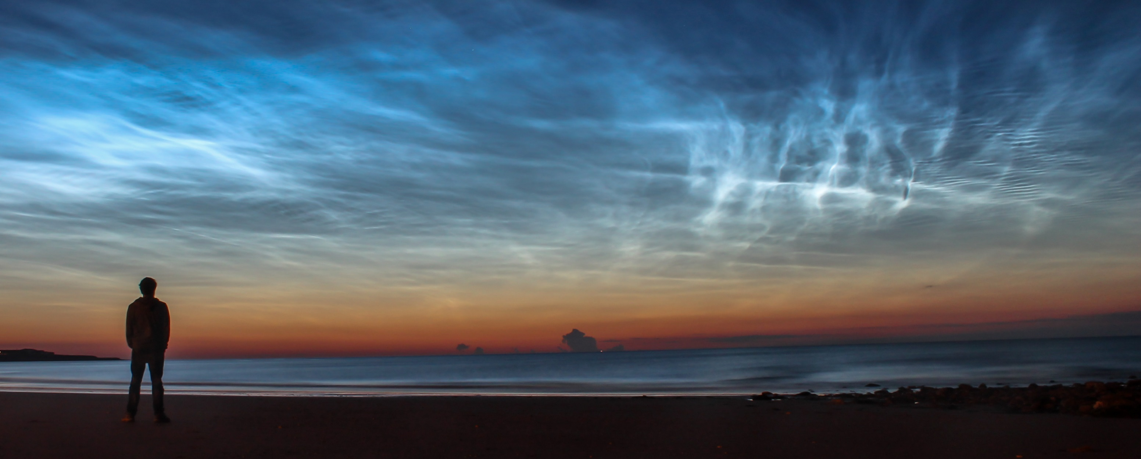
Noctilucent VR
Point Clouds in Virtual Reality

Slide 2
Noctilucent VR
Who are we?
Adam Puckette
Taylor Fahlman
Joshua Bowen

Slide 3
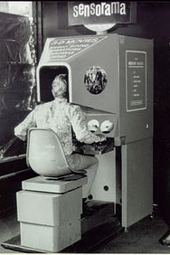
Noctilucent VR
What is it?
Virtual Reality Point Cloud Viewer

Slide 4
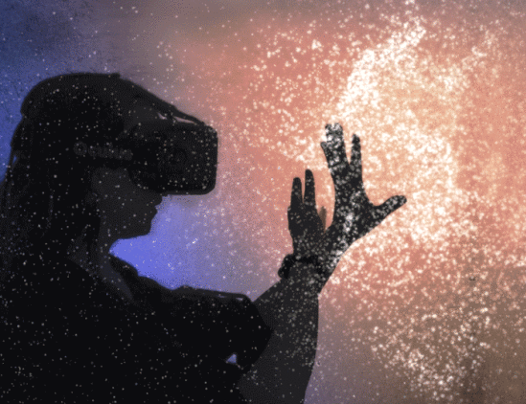
Lidar Point Clouds
What are they?
Bounce lasers to create points
XYZ and RGB of points stored
Cloud displays 3D data
Data displayed in VR

Slide 5
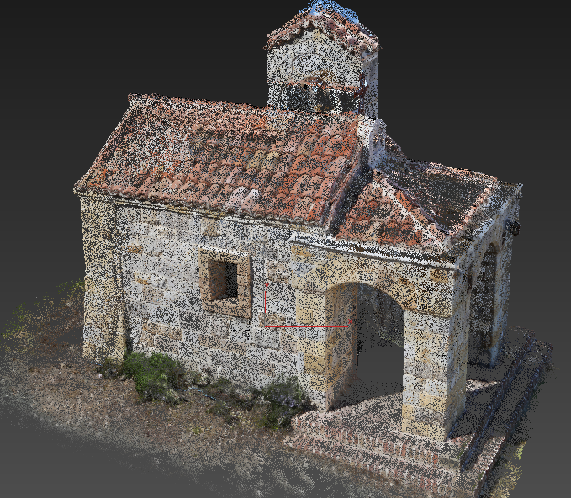
Lidar Point Clouds
What are they used for?
Earthquake Damage Inspection
Archiving Historical Monuments
Modeling

Slide 6
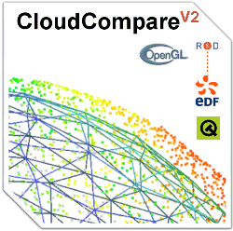
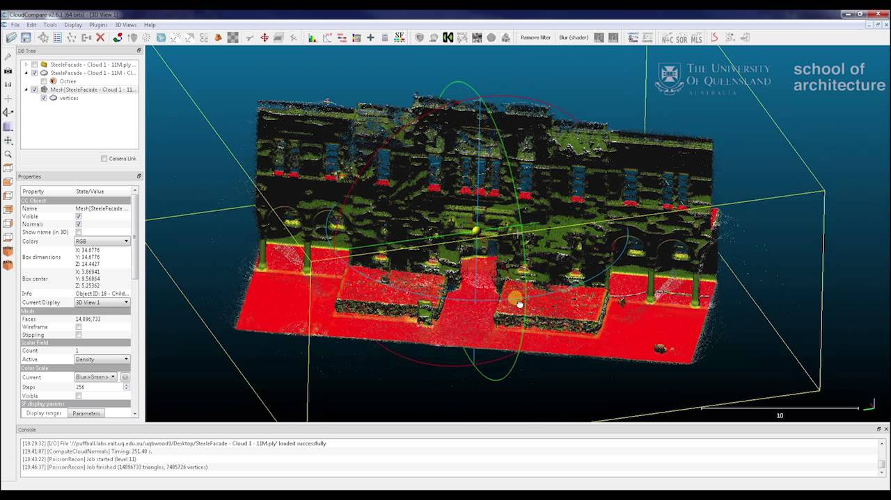
CloudCompare
What is It?
What does it Do?

Slide 7
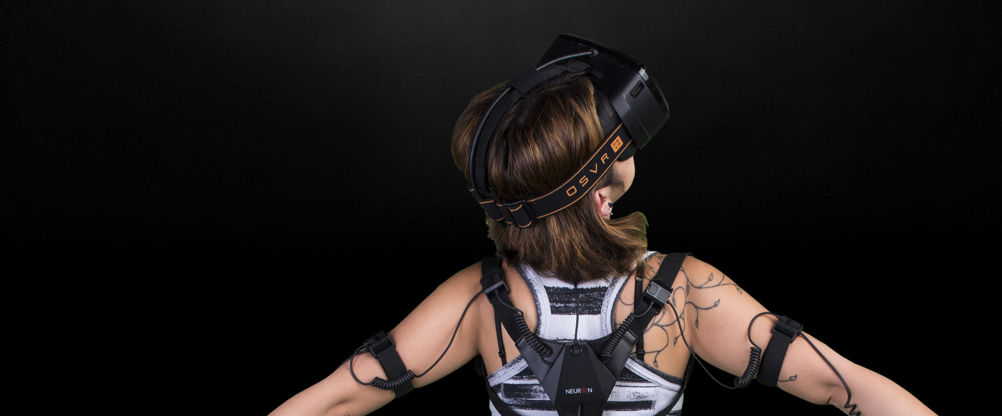
OSVR
What is it?

Slide 8
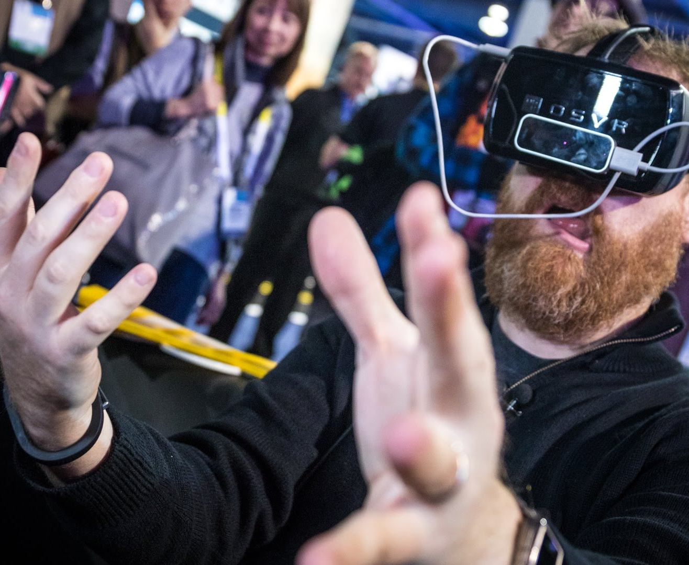
OSVR
Why OSVR?
Open-Source
Adaptable
Compatible with other hardware

Slide 9
Noctilucent VR
Free, open, and available to all

Slide 10

Fall 2016
Progress Report

Slide 11
Overview
First Meeting
Problem Statement
Requirements Document
Tech Review
Design Document

Slide 12

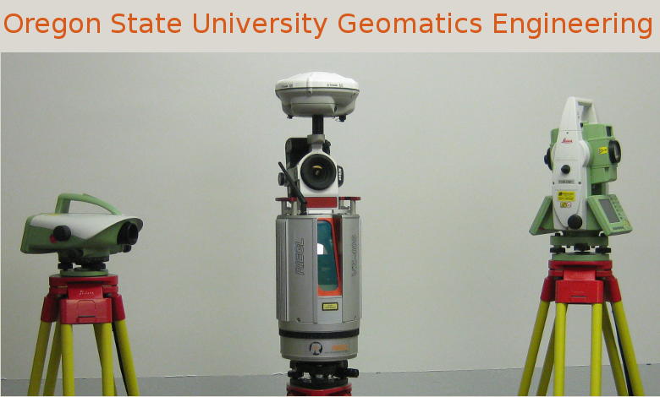
Matt O’Banion

Slide 13
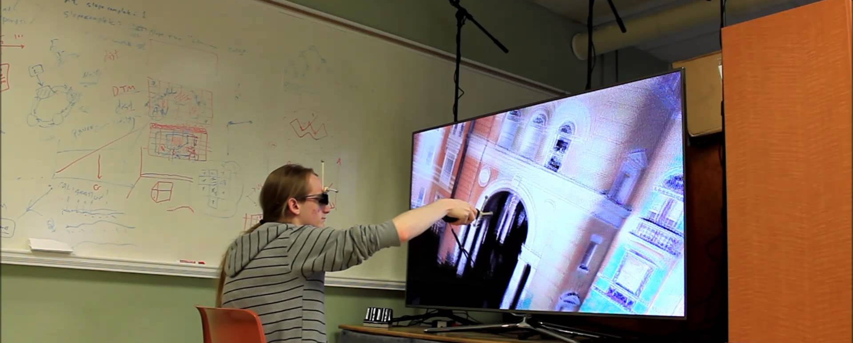
Current Setup
3D TV with modified Wiimote

Slide 14

Problem Statement
Project Abstract
Proposed Solution
Performance Metrics

Slide 15

Requirements Document
Detailed listing of user requirements
Performance
Compatibility
Usability

Slide 16
Tech Review
Virtual Reality Framework
UI Framework
VR Hardware
GPU Hardware
Peripheral Harware
Point Cloud Visualization Software

Slide 17

Virtual Reality Framework
Criteria
OSVR
Oculus DK
HTC Vive Steam VR DK

Slide 18

UI Framework
Citeria
QT
HTML/Javascript
GTK+

Slide 19
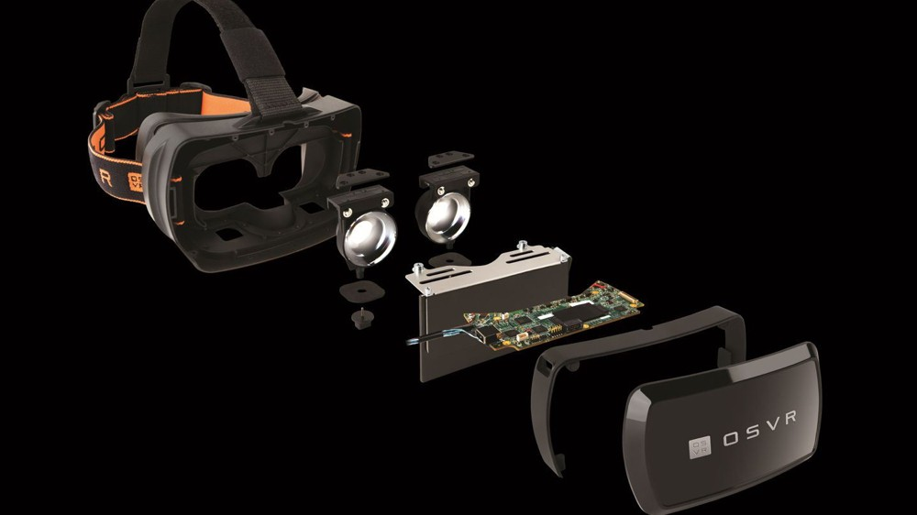
VR Hardware
Criteria
Oculus DK2
OSVR
HTC Vive

Slide 20
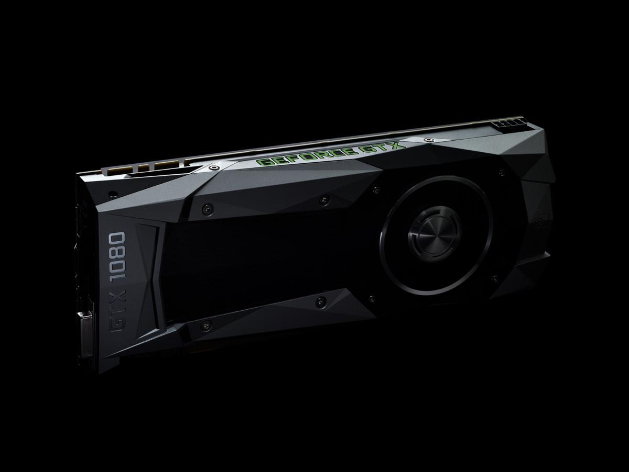
GPU Hardware
Criteria
GTX 770
GTX 970
GTX 1070

Slide 21

Peripheral Hardware
Criteria
Wiimote
Leap Motion
VIVE Controller

Slide 22
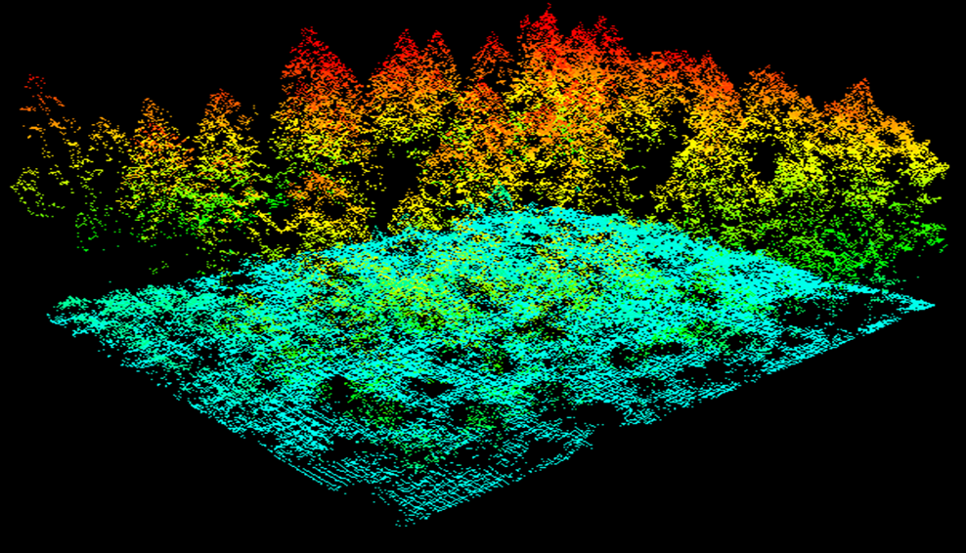
Point Cloud Visualization Software
Criteria
CloudCompare
Potree Viewer
LidarViewer

Slide 23

Design Document
Road map for the year
Big picture for the project
Living document

Slide 24
Project Status
What is done
What needs to be done
Potential Problems
Where we go from Here

Slide 25
Noctilucent VR
Point Clouds in Virtual Reality

